Slide 1
Inquiry Based Instruction
Multimedia Presentation
Notes:
Our teacher in action project was “Inquiry Based Instruction”.

Slide 2
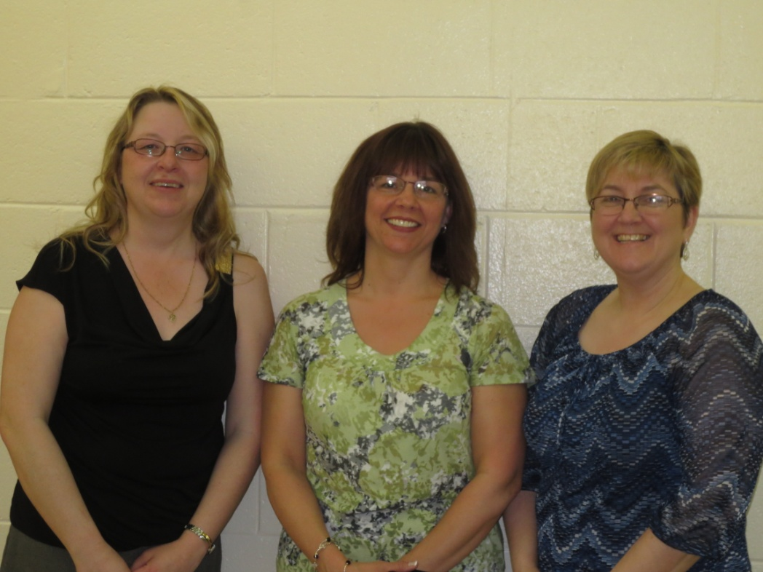
Teachers
Maxine Lushman
Renee Sherstobetoff
Lorina Spurrell
Notes:
The teachers involved were myself Maxine Lushman,
Renee Sherstobetoff, and
Lorina Spurrell at Humber Elementary School in Corner Brook.

Slide 3
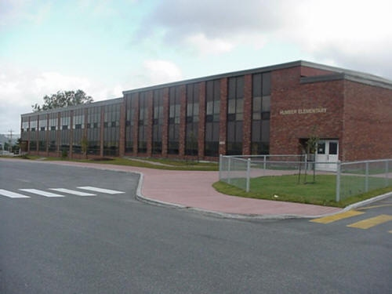
Humber Elementary School
K - 6 school
36 grade 5 students:
19 boys & 17 girls
Notes:
Humber Elementary is a K-6 school with a population of nearly 400 students. Renee holds the position of vice principal and Literacy Numeracy Support. Both myself and Lorina are two of the three grade 5 classroom teachers at our school. In both classes there are a total of 36 students, 19 boys and 17 girls with varying learning abilities and styles.

Slide 4
Teachers in Action
always looking to keep students motivated, interested and engaged
improve teaching practice in the area of science
develop inquiry based projects linked to current curriculum outcomes
Notes:
We decided to become involved in this project because despite inquiry based instruction being an integral part of the science curriculum, we found it difficult to implement true inquiry. As teachers, we are always looking for ways to encourage students to become active participants in their learning.

Slide 5
Our Beliefs
students should be given opportunities to explore, investigate and reflect
learning should be meaningful and authentic
Notes:
We believe that students learn best when given opportunities to explore their area of interest while engaging with new literacies and technologies.
Implementing inquiry based instruction would promote meaningful, authentic lifelong learning.

Slide 6
Research Question
Teacher Question
How do you balance open inquiry with prescribed outcomes?
Student Question
How does inquiry in science affect student interest, motivation, and engagement in the subject area?
Notes:
As teachers, we questioned how to balance open inquiry with the current outcome based curriculum.
Our focus became, “How does inquiry in science affect student interest, motivation, and engagement in the subject area?”

Slide 7
The Project

Slide 8
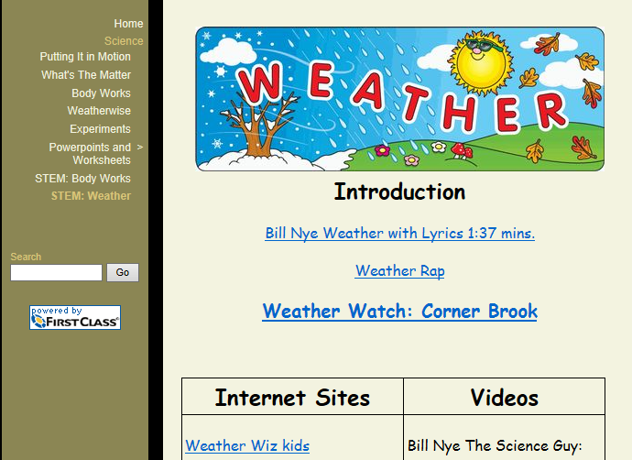
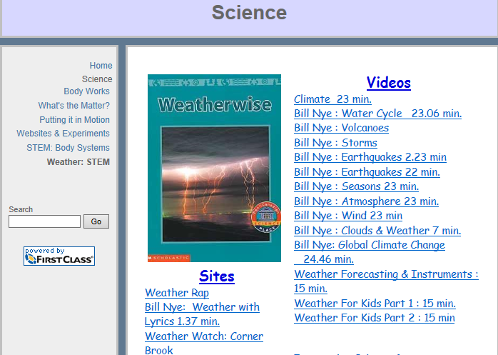
Preparation for the Project
article research
permission letter
pre - survey
resource webpages
student planning guides
student journals
Notes:
To get started, we read several research articles explaining inquiry based instruction. This investigation clarified the differing forms of inquiry and determined how we would approach the project with our students. We decided to follow the guided inquiry approach with our upcoming unit on weather.
Parents were informed of student rights as permission letters were sent home explaining the intent and expectations of the project.
A student survey was also created and delivered to determine students’ level of motivation, engagement, and interest prior to starting the project.
A webpage of resources, videos, and sites was developed for student research. This encouraged safe internet browsing.
A student planning guide was developed to assist their research.
A reflective journal was also included.

Slide 9
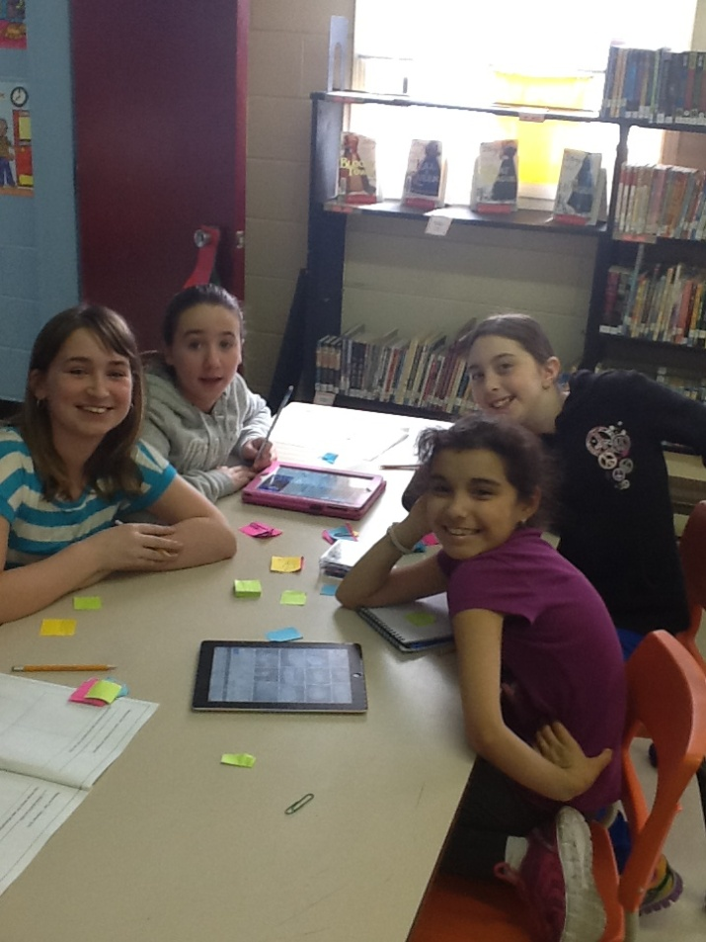
Notes:
To begin our project, we shared a “big question” related to weather and brainstormed topics associated with the question.

Slide 10
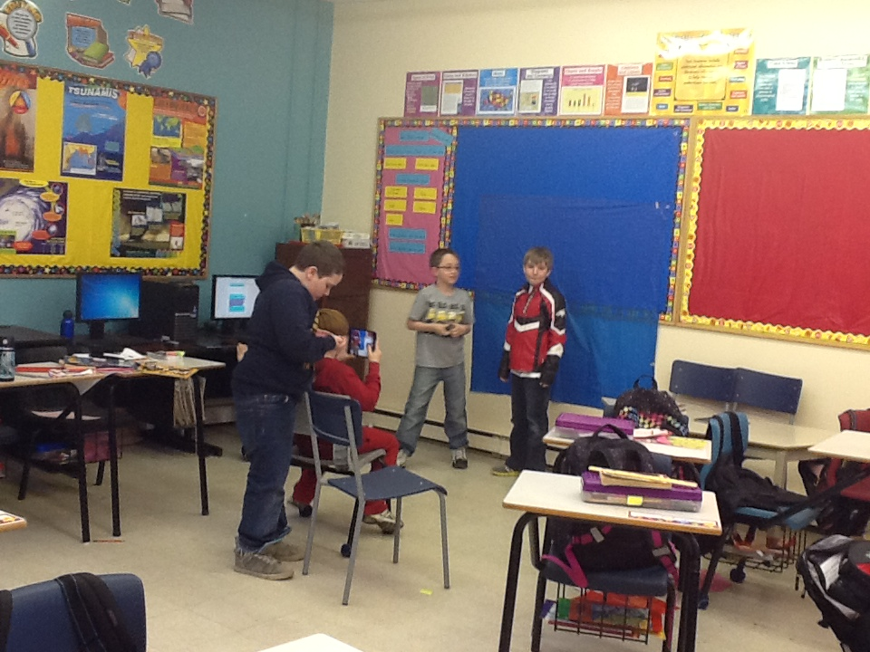
Notes:
From there, students chose a topic of interest, formed groups, and developed their own inquiry question.

Slide 11
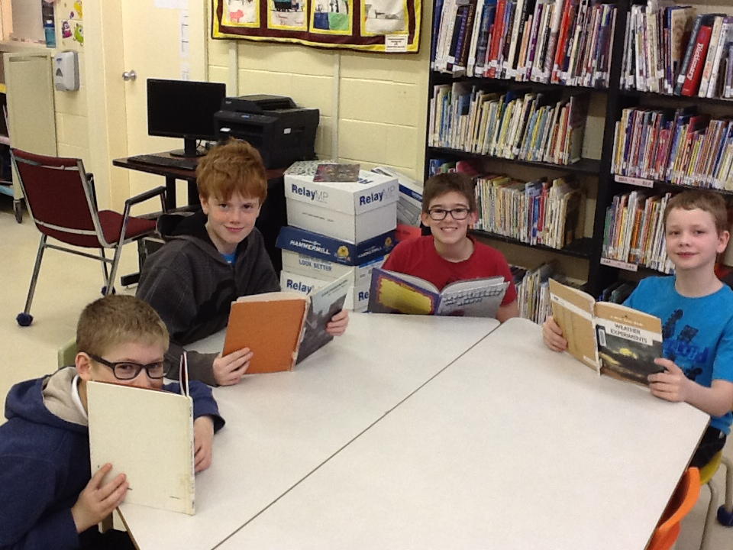
Notes:
They conducted research using informational texts, websites and videos to create their final project which was then presented to their peers.

Slide 12
Notes:
There were a number of additional 21st century learning skills that were enhanced through the inquiry. To assist with the development of this project we introduced and modelled Google Drive.

Slide 13
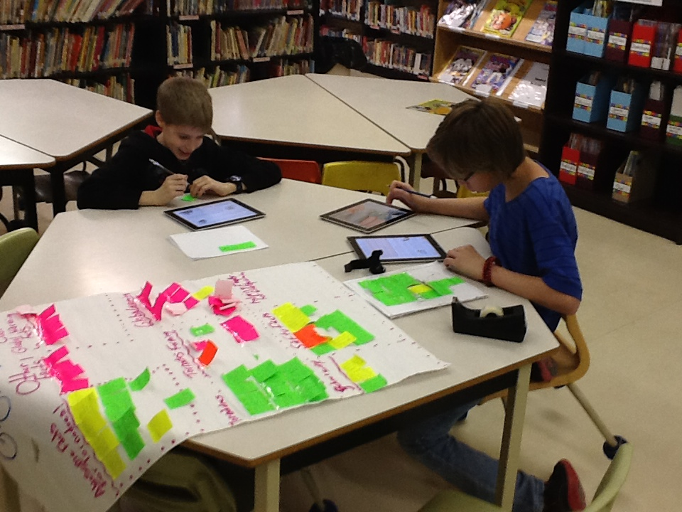
Notes:
Students were given individual accounts to allow collaboration amongst group members during the creation and development of their projects. These accounts also provided the students with an opportunity to reflect on their progress while in the comfort of their own home.

Slide 14
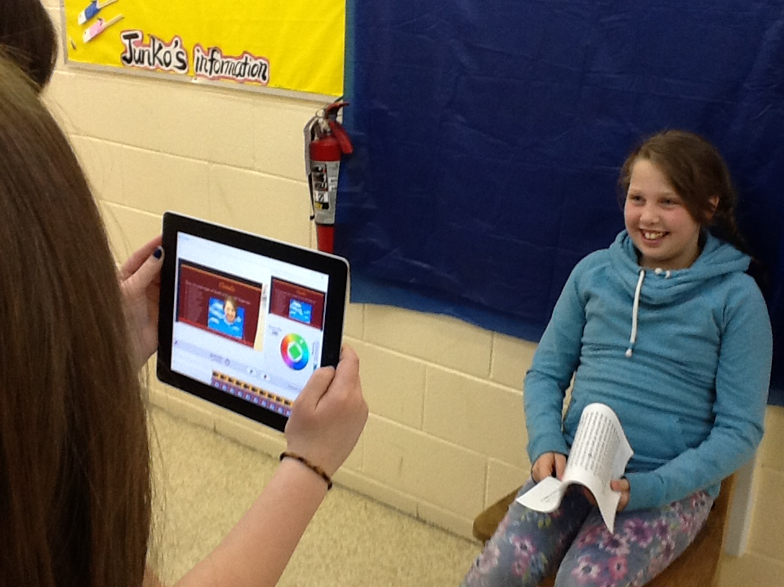
Notes:
Thanks to the recently acquired class set of iPads funded through the Humber Hold Travel App Project, students were exposed to this current technology.

Slide 15
Notes:
Students and teachers learned to use several apps, in particular “Greenscreen”.

Slide 16
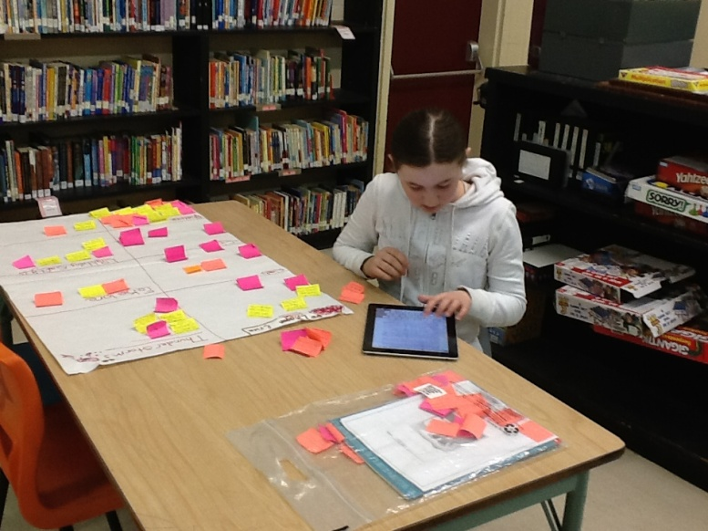
Notes:
Cross-curricular integration was easily achieved through the inquiry process. The new language arts curriculum provided excellent literature resources that allowed for modelling of key research skills including jot-noting, organizing, report writing, and presenting.

Slide 17
Data Collection
pre and post surveys
reflective journals
teacher observations
digital photos
interviews
video clips
Notes:
Before introducing the inquiry project, students completed a pre-survey as a means to collecting baseline data. This survey was also administered at the end to see if there were any changes.
Throughout the project, reflective journals were used by both students and teachers.
Teacher observations and digital photos were also collected.
At various point throughout the project, individual students and groups were interviewed using audio recordings and videos.

Slide 18
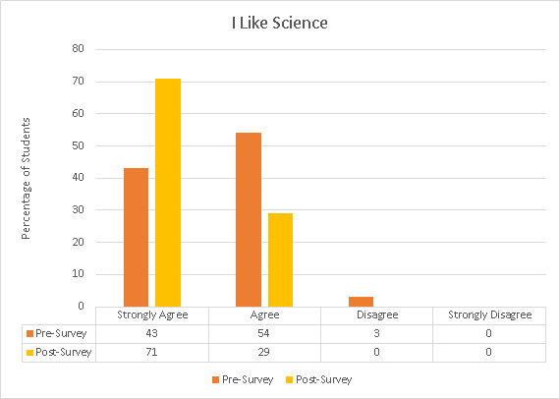
There was a
positive impact on
student attitude
toward science.
Notes:
From the surveys, we learned that prior to the project, 43% of our students strongly agreed with the statement “I like science”. After the project, we saw an increase of 28% in this category.

Slide 19
Supporting Data
Science is so much fun - Madison
I can’t wait for science class - Ariana
I love this science unit - Erica
I love this whole STEM project, it was amazing and so much fun - Olivia
Notes:
Every single student reported positive comments on learning science through an inquiry process.
Quotes taken from student journals reflected this attitude.
Daily teacher observations and video recordings illustrated this clearly as well.
Video

Slide 21
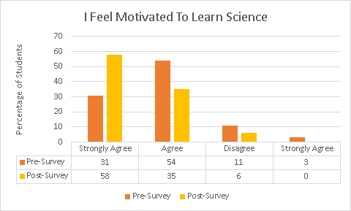
Inquiry based
learning had a
positive influence
on motivation.
Notes:
Post survey results indicated a 27% increase in the percentage of students strongly agreeing with feeling motivated to learn science.

Slide 22
Supporting Data
I would love more STEM and I would also love STEM every day - Gideon
I liked STEM a lot so I hope we keep doing it – Seth
My favorite part was filming the video for the second time because something I worked hard on actually turned out to work – Cole
Notes:
Students were eager to have science class and wanted to have it every day.
They were disappointed when it wasn’t in the schedule.
They loved working with their peers and were willing to put extra effort into completing each phase of the project.
Video

Slide 24
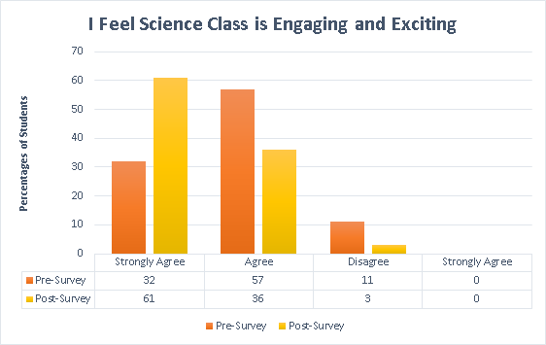
Science class
was viewed as
more exciting
and student
engagement
improved.
Notes:
In addition, there was a 29% increase in the percentage of students who strongly agreed that science class was engaging and exciting after completing their project.

Slide 25
Supporting Data
It is way better than sitting at our desks reading out of our textbooks, I get excited for science now – Leah
I really enjoyed going in a group and working with other people and getting the stuff ourselves and presenting - Evan
Students next year will love it, thanks for STEM – Adam
Notes:
Students looked forward to participating in science class.
They enjoyed collaborating with their peers, choosing their research topic and presenting their findings and evidence.
Students encouraged the continuation of the inquiry approach for future classes.
Video

Slide 27
Notes:
Given the level of improvement in engagement and motivation, we will certainly be continuing inquiry in the future. Students’ interest in science was enhanced; they enjoyed collaborating with their peers and liked being given choice throughout the inquiry process.

Slide 28
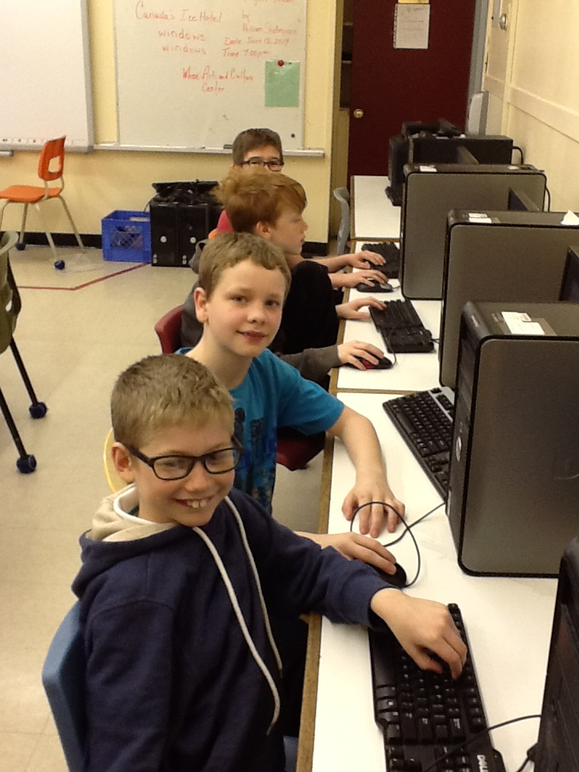
Notes:
They became responsible and accountable for their own learning. Having access to various technologies increased time on task, therefore behavioural issues were minimal. Students’ problem solving skills developed naturally as they found solutions to daily concerns.

Slide 29
Notes:
As teachers, we discovered that matching inquiry to our outcomes based curriculum had its own difficulties. Given that students were able to choose their topic of investigation, some outcomes were not addressed. Therefore, we needed to use our professional judgement to ensure that these outcomes were met.

Slide 30
Notes:
At our school, we were fortunate to have access to various technologies, therefore students availed of current research and information. The availability of these technologies may differ from year to year.

Slide 31
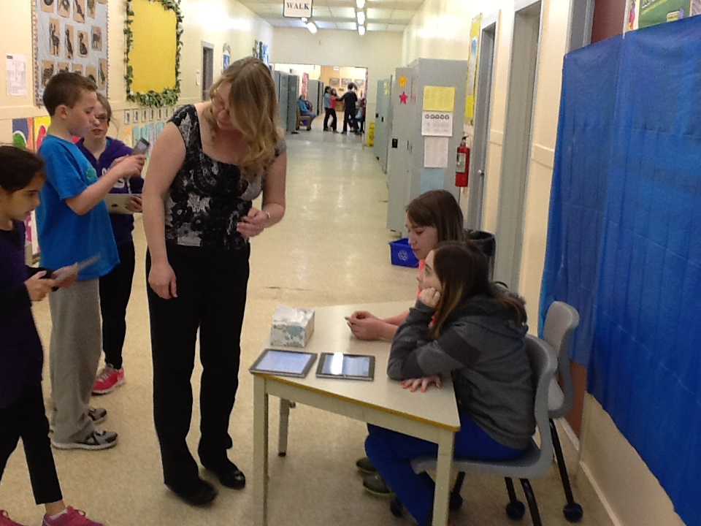
Notes:
It is absolutely necessary for teachers to develop assessment tools, establish expectations, and provide on-going feedback. As a result, students would be aware of the guidelines necessary for successful completion of their inquiry projects.

Slide 32
Final Thoughts
Notes:
Taking part in this project has shown us the necessity of continually learning. We must be open to the numerous opportunities there are for professional growth. By participating in this teacher inquiry, we have gained another valuable instructional strategy for enhancing student learning while creating a positive classroom atmosphere.

Slide 33
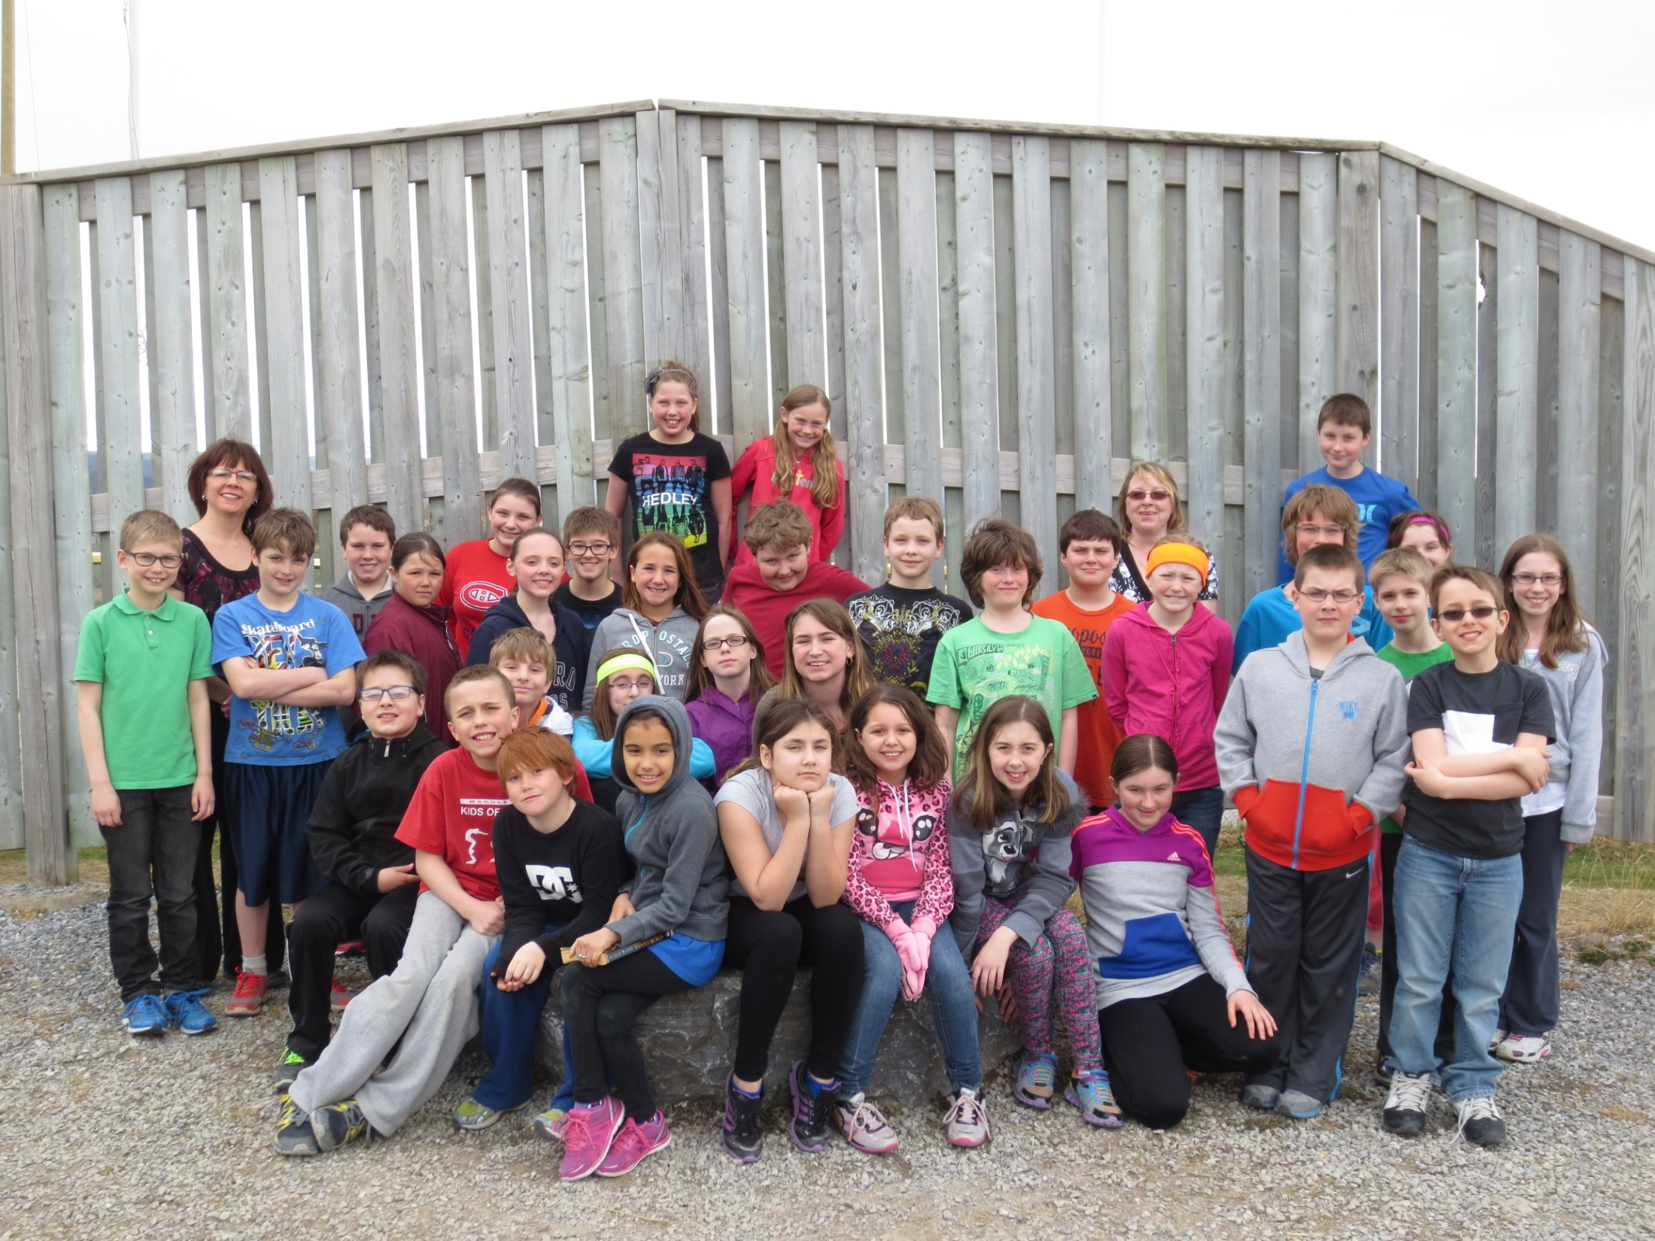
Notes:
The results have far exceeded our expectations. As teachers we have grown both professional and personally. The importance of lifelong learning within our field is essential for meeting the current technological needs of our society and our students. An effective teacher recognizes the individual needs and learning styles of their students ensuring maximum learning is achieved.

Slide 34
Credits
Special Thanks to:
Andrea Neville
Christine Elliott
Humber Elementary Administration and Staff
Teachers in Action Facilitators
Karen Good
Tom Walsh
Rene Wicks

